Slide 1


ONLINE RESUME BUILDER USING JAVA
ONLINE RESUME BUILDER
Guided By : Work Done By:
Dr.buvaneshvari K.Jaya Sai Akash
(Course Faculty) (192111528)
Java programing Computer science engineering
Saveetha School of Engineering Saveetha School of Engineering

Slide 2
ONLINE RESUME BUILDER
ABSTRACT :
A resume is a crucial document for job seekers, and having an intuitive and efficient tool to create and manage it can significantly aid individuals in their job search process. The online resume builder will provide users with a user-friendly interface to input their personal information, education background, work experience, skills, and other relevant details, and generate a professional-looking resume in various formats

Slide 3
INTRODUCTION
The online resume builder using Java is designed to streamline the process of creating professional resumes for job seekers
Users can access the platform from any internet-enabled device, providing convenience and flexibility.
Featuring an intuitive interface, the builder simplifies the resume creation process for users of all skill levels.
users can personalize their resumes with various templates, layouts, and design elements to match their preferences and career

Slide 4
APPLICATIONS OF ONLINE RESUME BUILDER
Job applications
Career advancement
Internship applications
Professinal development
Career fairs
BENEFITS OF ONLINE RESUME BUILDER:
convenience
Time saving
Customization
Cost effictive
These benefits make online resume builders a valuable tool for job seekers looking to create professional resumes quickly and effectively.

Slide 5
PROBLEM DEFINATION
To design and develop a web-based platform using Java that allows users to create professional resumes efficiently. The system should provide intuitive tools and customizable templates to facilitate the input of personal information, work experience, education, skills, and other relevant details. The goal is to offer users a user-friendly interface for creating and formatting resumes, with options for customization and flexibility. Additionally, the system should prioritize data security, ensuring the protection of user information and compliance with privacy regulations. The project aims to address the need for individuals to easily create and manage their resumes online, streamlining the job application process and enhancing their chances of securing employment opportunities."

Slide 6
COMPONENTS REQUIRED
Software Requirements:
Windows 7 and above
Microsoft SQL Server
Visual Studio
Java version
Hardware Components:
Processor – i3
Hard Disk – 5 GB
Memory – 1GB RAM

Slide 7
PROBLEMS IDENTIFIED
Scalability: Ensuring the system can handle a large number of users and resumes without performance degradation..
User Experience : Improving the user interface and experience to make the resume creation process intuitive and efficient.
documentation: Providing comprehensive documentation for developers and users to understand the functionality and usage of the system.
Error handling: Implementing proper error handling and validation to guide users in creating accurate and error-free resumes.

Slide 8
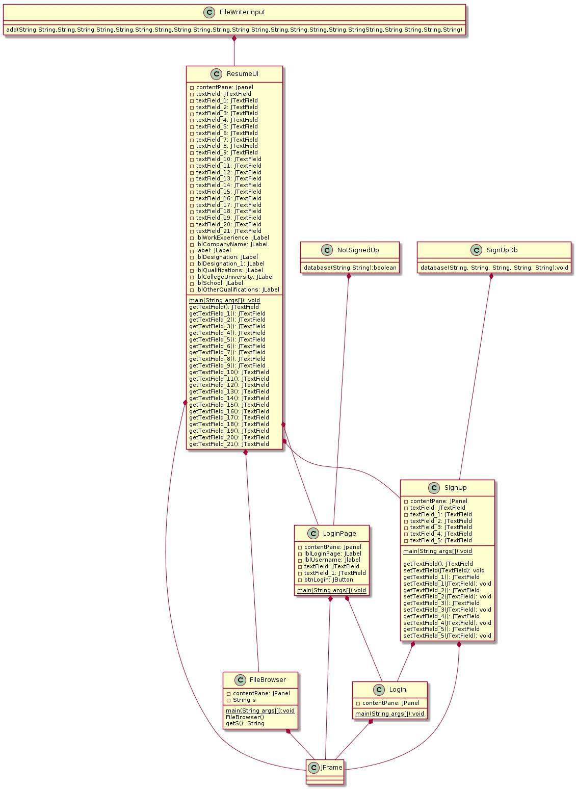
U I INTERFERE REPRESENTATION

Slide 9
^{Signing Frame:}
Signature input field (if electronic signature is required)
Clear button to erase the signature
Confirmation checkbox for agreeing to terms
Date field for when the signature was made
^{Save or submit button}
Resume UI:
Personal information section (name, contact details)
Summary or objective section
Work experience section (company name, job title, dates, responsibilities, achievements)
Education section (degree, institution, dates)
Skills section (technical skills, soft skills)
Certifications/licenses section
Volunteer work or extracurricular activities section
References section (optional)
Formatting options (font styles, sizes, colors)
Download or print button

Slide 10
WORKING INTERFACE
^{Firewall Login/Signup:}
Additional security measures like two-factor authentication (2FA)
^{Verification code input field}
Confirmation link sent via email for account activation (if applicable)
Terms of service and privacy policy links
Captcha or reCAPTCHA for spam prevention
^{Login Page:}
^{Username field}
^{Password field}
^{"Forgot password" link}
^{"Remember me" checkbox}
^{Sign-in button}
^{Sign-up link/button}
Social media login options (if applicable)
Error messages for incorrect login attempts

Slide 11
EXISTING SYSTEM
User Registration and Authentication: Users can create accounts and log in securely to access the resume building functionalities.
Resume Creation Interface: An intuitive user interface allows users to input their personal details, education, work experience, skills, and other relevant information to generate a professional resume..
Template Selection: Users can choose from a selection of pre-designed resume templates that suit their preferences and the industry they are targeting.
Customization Options: The system offers customization options such as font styles, colors, layout configurations, and section additions/removals to tailor the resume according to the user's preferences
Preview and Editing: Users can preview their resumes in real-time and make edits as needed before finalizing the document.
Exporting Options: Once the resume is completed, users can download it in various formats such as PDF, Word document, or plain text for easy sharing and printing.

Slide 12
PROPOSED SYSTEM
User Authentication and Authorization: Implement a secure authentication system to allow users to create accounts and log in securely. Authorization mechanisms can control access to specific features based on user roles.
User Profile Management: Allow users to create and manage their profiles, including personal information, contact details, and employment history
Resume Templates: Provide a variety of customizable resume templates for users to choose from, catering to different industries and job roles.
Dynamic Resume Editing: Implement an intuitive and user-friendly interface for users to easily edit and customize their resumes. This could include features like drag-and-drop sections, live preview, and real-time editing.
Section Customization: Allow users to add, remove, and rearrange sections in their resumes to highlight their skills, experiences, education, and achievements effectively.
Data Privacy and Security: Implement robust security measures to protect user data, including encryption of sensitive information, secure storage practices, and compliance with data privacy regulations.

Slide 13
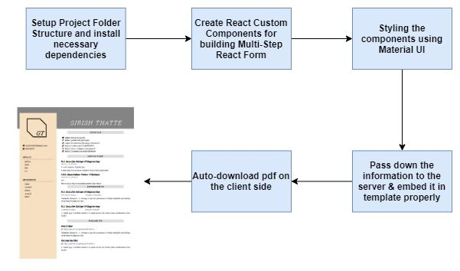
ONLINE RESUME ARCHITECTURE

Slide 14
High-Level Approach
Create a basic client-server setup of Node & React and install necessary libraries required.
Build a React form by making modularized components using Material UI and React-Boostrap & calling these components in sequence to get required input data to generate resume.
Process the information on the server(Node) and using some HTML to PDF libraries to generate the resume.
Finally, make it auto-download on client side.

Slide 15
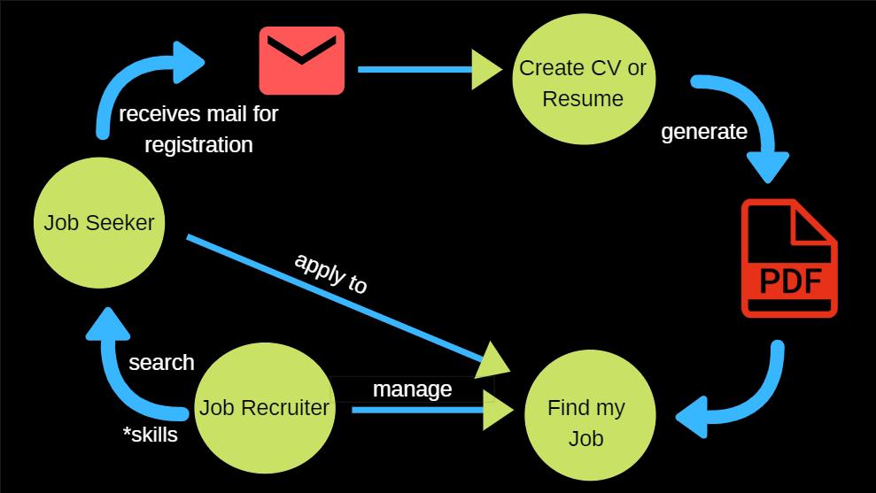
FLOWCHART

Slide 16
ADVANTAGES
^{Accessibility}
^{Platform Independence}
^{User-Friendly Interface}
^{Cost-Effective}

Slide 17
LIMITATIONS
Despite offering various templates and customization options, some users may find the level of customization limited compared to desktop-based resume building software. Advanced formatting options or design flexibility may be restricted in a web-based environment.
Users need a stable internet connection to access and use the online resume builder.
Storing personal and sensitive information online raises security concerns.
: Users may have concerns about their privacy and the confidentiality of their personal information when using an online resume builder
Depending on server load and network latency, users may experience performance issues such as slow loading times or unresponsiveness, particularly during peak usage periods

Slide 18
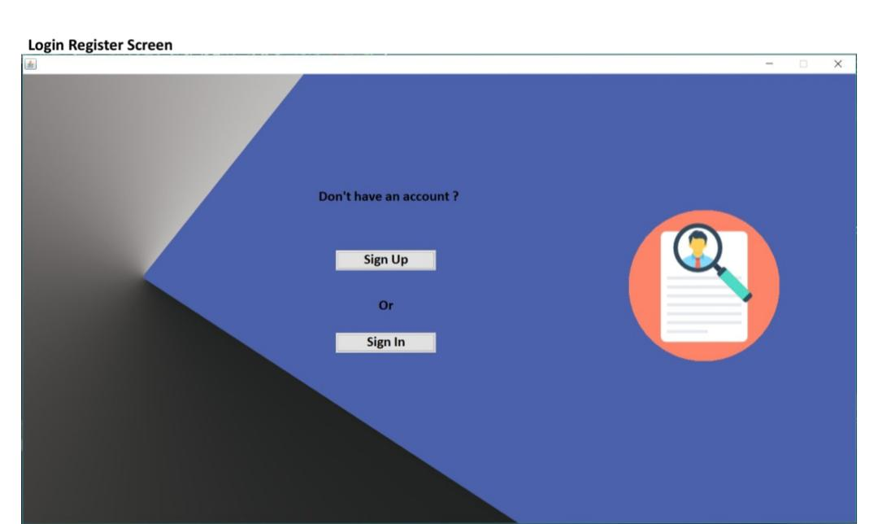
OUTPUT

Slide 19
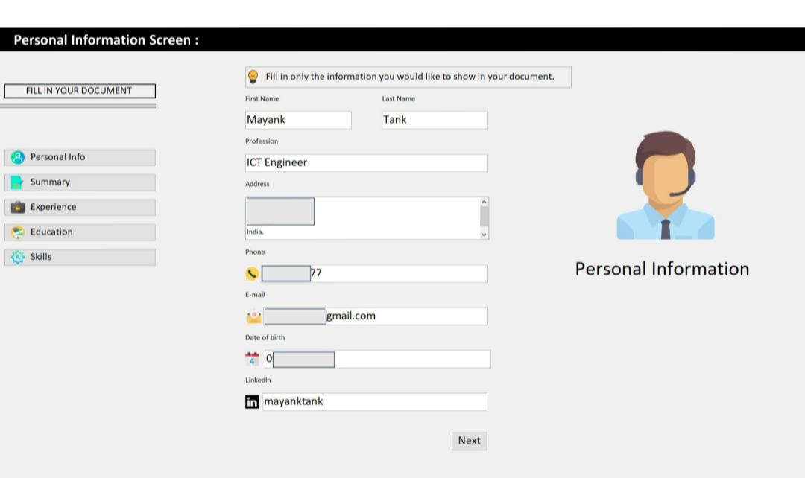

Slide 20

ADMIN SCREEN

Slide 21
FUTURE SCOPE
Implement data analytics capabilities to track user engagement, analyze usage patterns, and gather insights for further optimizing the platform's features and user experience.
^{. Data Analytics}
^{Mobile Application}
^{Collaborative Editing}
By pursuing these avenues of development, the online resume builder using Java project can evolve into a comprehensive and indispensable tool for job seekers worldwide, empowering them to create compelling resumes that effectively showcase their skills and experiences.

Slide 22
CONCLUSION
the online resume builder Java project has successfully demonstrated the capability to streamline the resume creation process for users, providing them with a user-friendly interface and powerful functionality. By leveraging Java's robustness and versatility, we've created a platform-independent solution that can be accessed and utilized by a wide range of users.
Overall, this project showcases the potential of Java in building practical and scalable web applications while empowering individuals in their career pursuits

Slide 23
REFERENCES
http://ieeexplore.ieee.org/xpl/articleDetails.jsp?tp=&arnumber=4230933&queryText%3DCV+Generation+System
http://ieeexplore.ieee.org/xpl/articleDetails.jsp?tp=&arnumber=552594&queryText%3DResumes
http://ieeexplore.ieee.org/xpl/articleDetails.jsp?tp=&arnumber=722095&queryText%3DResumes

